Slide 1

Citizen Equality
Bruce Skarin – www.bruceskarin.com
&
Jamie Melhuish
Notes:
Greetings America, its time we had a serious conversation about citizen equality. Now wait, wait, I know this is long and not exactly the most enjoyable topic, but it is probably the most important conversation our generation will ever have. So bookmark this, put it in a calendar, and make some time to watch it with friends and family, because if you have even the slightest bit of love for our country, you will want to see this.

Slide 2
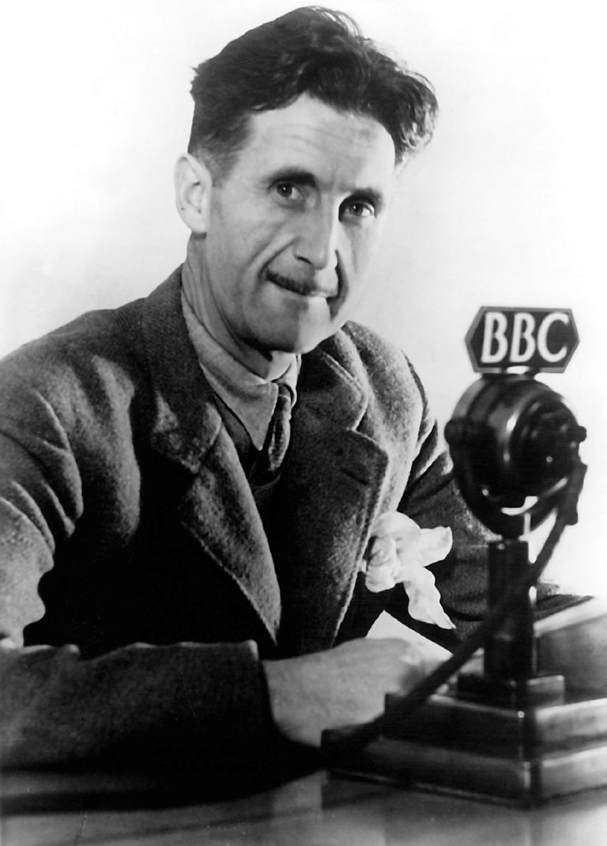
“All animals are equal, but some animals are more equal than others.”
― George Orwell, Animal Farm
Notes:
Alright, so I want to begin with this entertaining quote in Orwell’s Animal Farm where the pigs say “all animals are equal, but some animals are more equal than others.”

Slide 3
As citizens, are we equal?
Notes:
Now we might chuckle at this, what we all should be doing is asking ourselves: as citizens, are we equal?

Slide 4

Notes:
And to that we might say, well yes of course, because we all have freedom of speech

Slide 5

Notes:
Freedom of religion

Slide 6

Notes:
The right to assemble

Slide 7

Notes:
And the right to bear arms

Slide 8
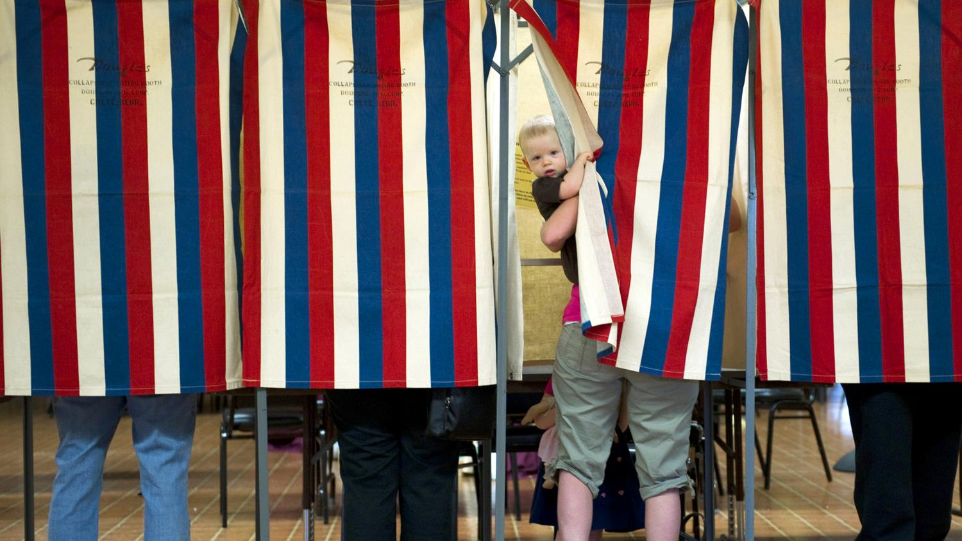
Notes:
We each get one vote

Slide 9
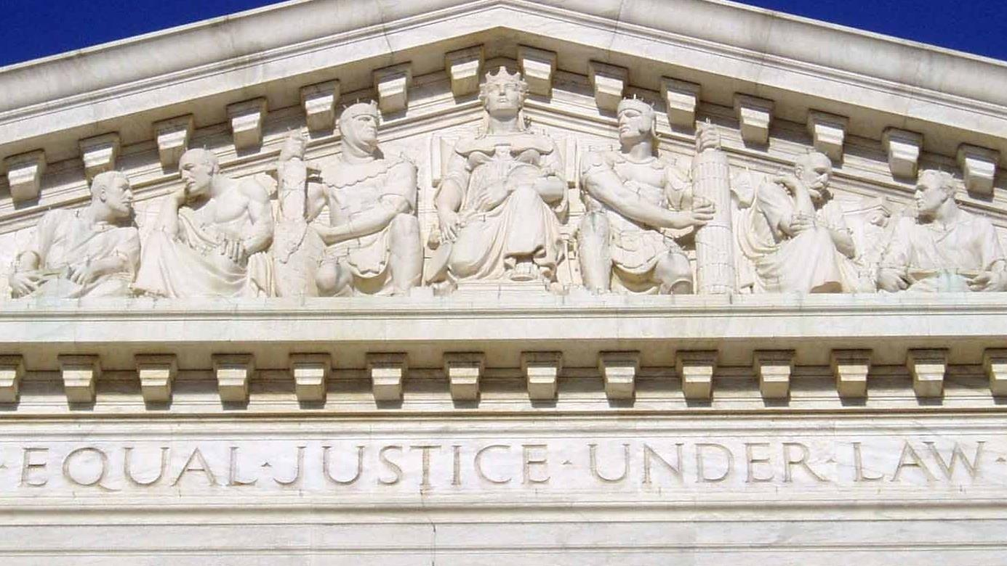
Notes:
We are all entitled to due process under the law

Slide 10
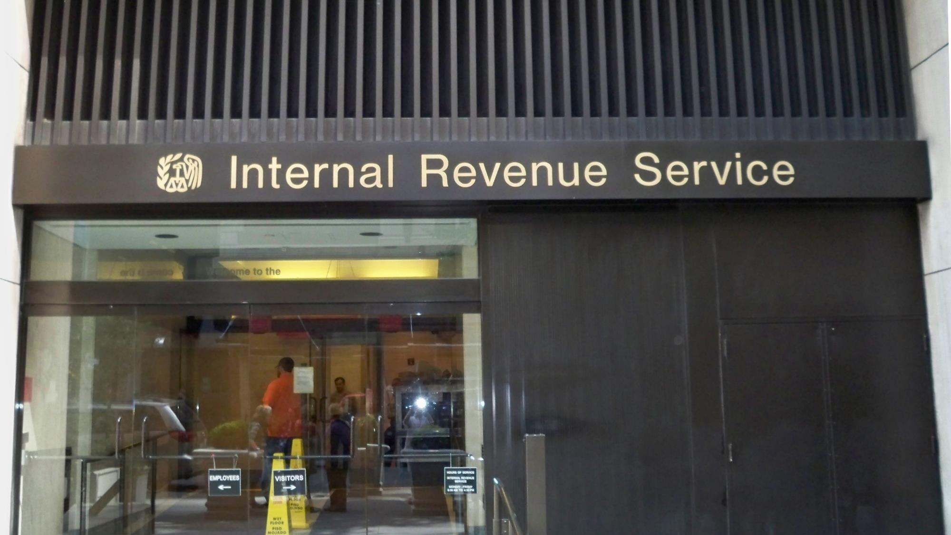
Notes:
And that nobody escapes all taxes

Slide 11
Yet as citizens, are we still equal?
Notes:
Yet as citizens, are we still equal?

Slide 12

“The core principle of representative democracy is that we are all equal citizens.
Corruption creates 2nd class citizens.”
― Lawrence Lessig (2015)
Notes:
Well here is what Harvard Law professor Lawrence Lessig has to say in exploring a run for president that is focused exclusively on citizen equality, he says:
“the core principle of representative democracy is that we are all equal citizens.” and that “Corruption creates second class citizens.”

Slide 13
Corruption, creates 2nd class citizens
Notes:
Corruption, creates 2nd class citizens

Slide 14
Institutional Corruption
Notes:
And by corruption, he isn’t talking about that narrow definition of directly exchanging money for favors, which is already illegal, he is talking about institutional corruption

Slide 15
What is Institutional Corruption?
“Institutional corruption is manifest when there is a systemic and strategic influence which is legal, or even currently ethical, that undermines the institution’s effectiveness by diverting it from its purpose or weakening its ability to achieve its purpose, including, to the extent relevant to its purpose, weakening either the public’s trust in that institution or the institution’s inherent trustworthiness.” –Lawrence Lessig (2014)
Notes:
Which he defines in an earlier paper as follows. Now I know this is a pretty long and complex definition, so lets break it down and see how it might apply to Congress, and more specifically to the House of Representatives.

Slide 16
What is Institutional Corruption?
“Institutional corruption is manifest when there is a systemic and strategic influence which is legal, or even currently ethical, that undermines the institution’s effectiveness by diverting it from its purpose or weakening its ability to achieve its purpose, including, to the extent relevant to its purpose, weakening either the public’s trust in that institution or the institution’s inherent trustworthiness.” –Lawrence Lessig (2014)
Notes:
So what is institutional corruption? Well it begins with a “systemic and strategic influence which is legal, or even currently ethical,”

Slide 17
Notes:
So for the House we can look at this systematic growth in contributions to winning campaigns. Impressive right? Just imagine a time, when the average cost of a winning campaign was less than sixty-thousand dollars. As compared to today, where the average is now almost two million dollars, pushing the total cost for winners towards a cold hard billion dollars.

Slide 18
Notes:
And when we look at the more recent distributions of these contributions what we find is that the amounts under $200, are completely insignificant, while the elite amounts over $2,700 have now overtaken all other individual contributions. And on top of all that, we have the political action committees, or PACs, which are not the same as those Super PACs and that dark money you have been hearing all about. This is just the money that is given directly to candidates.

Slide 19
Notes:
Another way to look at this is to see how back in the 90s, elites gave less than 10 times as much money, as those afforded by the middle class, but by 2014 they now contribute 233 times as much money, and this is showing now signs of stopping.

Slide 20
Notes:
In addition to perfectly legal contributions, we also have perfectly legal lobbyists, whose numbers have grown prodigiously since the 70s

Slide 21
Notes:
Along with the spending on lobbyists, which now regularly tops three billion dollars.

Slide 22
What is Institutional Corruption?
“Institutional corruption is manifest when there is a systemic and strategic influence which is legal, or even currently ethical, that undermines the institution’s effectiveness by diverting it from its purpose or weakening its ability to achieve its purpose, including, to the extent relevant to its purpose, weakening either the public’s trust in that institution or the institution’s inherent trustworthiness.” –Lawrence Lessig (2014)
Notes:
Okay, so now that we have two aspects that just might have a little systemic and strategic influence, let’s ask whether or not it is undermining the effectiveness of Congress in achieving its purpose.

Slide 23
Notes:
And for that we can look at the number of bills enacted, which have been steadily declining in blue, versus the total number of pages in red, which have grown substantially.

Slide 24
Notes:
Now what this means is that the average number of pages per bill has been steadily increasing, which is why we now have representatives telling us that they have no clue about what is in the bills they are voting on, because they are too big and too complex and they simply do not have the time to read them. But, are these increases actually biased towards anyone?

Slide 25
Notes:
Well when we look at the tax rate for the top ten percent of households, we do see a steady decline

Slide 26
Notes:
And as a result of this and other related factors, when we look at household incomes, we see that the middle class has grown only a little and now appears to be totally flat at around fifty thousand dollars per year, whereas the top five percent has enjoyed significant growth.

Slide 27
Notes:
Put another way, back in the 60s the top five percent only made four times as much as the middle class, not too shabby, but around the 80s things really took off to where they are now today in making over six times as much, which roughly translates into an average four-thousand to eight-thousand dollar pay cut for the middle class and a forty-thousand to eight hundred thousand dollar raise for elites.

Slide 28
What is Institutional Corruption?
“Institutional corruption is manifest when there is a systemic and strategic influence which is legal, or even currently ethical, that undermines the institution’s effectiveness by diverting it from its purpose or weakening its ability to achieve its purpose, including, to the extent relevant to its purpose, weakening either the public’s trust in that institution or the institution’s inherent trustworthiness.” –Lawrence Lessig (2014)
Notes:
Okay, so now what about the last part? Has this weakened the our trust in Congress?

Slide 29
Notes:
Well according to polls of that very question, yes, our trust has gone from an age when over three-quarters of the population trusted our government to a time when barely twenty percent of Americans have any faith in the institution.

Slide 30
Notes:
And when we look at voter registration and turnout during mid-term elections, which is a good baseline measure of our political participation, we see that the numbers have grown more slowly than the population.

Slide 31
Notes:
Which means that the percentage of people registered and going to the polls has been in a steady decline.

Slide 32
So as citizens, are we still equal?
Notes:
So as citizens, are we still equal?

Slide 33
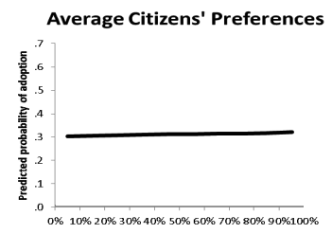
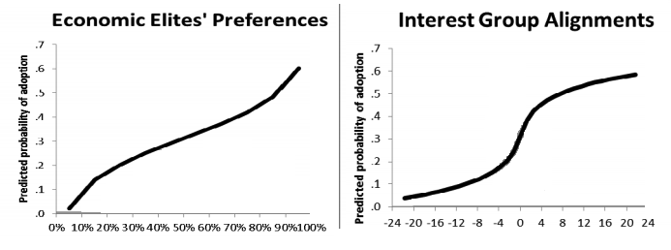
“When the preferences of economic elites and the stands of organized interest groups are controlled for, the preferences of the average American appear to have only a minuscule, near-zero, statistically non-significant impact upon public policy” – Gilens and Page (2014)
Notes:
Well to provide a definitive answer we can look at the landmark study done by Gilens and Page that evaluated decades of history to discover what Ezra Klein called “the most terrifying graph about democracy.” Now you might wonder what could possibly be so scary about a simple straight line, but what this is actually saying is that when nearly zero percent of the population cares about a reform, three times out of ten, something happens. And when the people are unanimous, meaning that this is something nearly everyone really cares about, there is still only a three in ten chance of something happening.
But when you compare this to elites and interest groups, we find a very responsive Congress that avoids issues that elites are against, and that takes action six out of every ten times when it comes to something that they really want.
Put even more plainly, what this means is that the vast majority of Americans now have quote “only a minuscule, near-zero, statistically non-significant impact upon public policy”

Slide 34
As citizens, are we equal?
Notes:
Okay, so when I ask this quesiton one last time: As citizens, are we equal?

Slide 35
no
Notes:
We can now say without any shred of doubt, that the answer is, No, no we are not equals

Slide 36
All citizens are equal, but some citizens are more equal than others.
Notes:
We are in fact now living in Orwellian times, where we like to say that, here in America we are all equal citizens, but in truth, some citizens are undeniably more equal than others

Slide 37
How do we fix it?
Notes:
Okay, by now I can imagine many of you are nodding your heads and saying yes, I have heard a lot of this before. I get it, but honestly, what can we really do? How do we fix it?

Slide 38








Notes:
Well if you have been paying much attention to this issue, you would already know that there are a lot of groups out there pushing for reforms from a number of different angles, and this a great, because problems like this require a lot of exploration. Yet I also think that each group out there would also be the first to admit that they alone do not have a complete solution. Now is the time to put it all together though.

Slide 39
How did we get here?
Notes:
Now I promise, there is a really is a good answer to the question as to how we actually restore equality, but in order for you to truly believe it, we first have to answer a different question: How did we get here?

Slide 40
-
elite favorable
Trust In
Voter
policy ratio
+
Government
Participation
-
R
Elitism
-
Loops
+
Middle Class
+
Cost per
Income
Middle Class
R
+
Favorable Policy
Impression
+
Middle Class
Voter
-
Political Investment
Elite Favorable
Influence
Crony Capitalism
Policy
+
Congressional Favoritism
Loops
+
+
Voter
R
Toward Elites
R
Engagement
Lobbyist Policy
+
Middle Class
+
Transparency
+
Contributions
Total Campaign
R
Contributions Under $200
Leverage Effect
Expenditures
-
+
Elite Income
+
Indicated Elite
+
Influence
+
Registered
Lobbying
indicated number
Lobbyists
Gains
of lobbyists
Total Contributions to
+
-
+
R
Winning Campaigns
+
+
+
+
-
+
Elite
Lobbyist Cost
Total Spending
Desired Campaign
Influence
Desired
on Lobbyists
Expected Campaign
Budget
Lobbyists
Elite Political
Shortfall
R
+
Investment
B
B
-
Elite Contributions
+
Over $2700
available funds for
Potential
+
hiring new lobbyists
Spending on
+
+
Lobbyists
politician effort contacting
+
important donors
Notes:
Here is the answer. Now I know this might seem too complicated to understand, but we will again take it one piece at time. What this diagram represents are the major feedback loops of a system dynamics model that puts together all that data we just looked at, and more, to provide a mathematically complete explanation of the rise of institutional corruption and how we got to where we are today. From there we can then use this model to actually look into the future and see how different policies work, and which will be the most effective in restoring citizen equality.

Slide 41
Crony Capitalism
Congressional Favoritism
Loops
Toward Elites
R
Notes:
Alright, so the first set of loops that we will look at are called the crony capitalism loops, which are all going to reinforce or amplify the growth of corruption and it begins with that notion of elite favoritism in Congress that Gilens and Page measured.

Slide 42
Crony Capitalism
Congressional Favoritism
Loops
Toward Elites
R
+
Indicated Elite
Influence
+
Elite Contributions
Over $2700
Notes:
This favoritism is driven by elite influence, which is in part determined by our representatives dependence on large dollar contributions

Slide 43
Crony Capitalism
Congressional Favoritism
Loops
Toward Elites
R
+
Elite Income
Indicated Elite
Influence
+
+
Elite Political
Investment
Elite Contributions
Over $2700
+
Notes:
These contributions come from elite political investments, which are based on elite income.

Slide 44
+
Elite Favorable
Crony Capitalism
Policy
Congressional Favoritism
Loops
Toward Elites
R
+
+
Elite Income
Indicated Elite
Influence
+
+
Elite
Influence
Elite Political
R
Investment
Elite Contributions
Over $2700
+
Notes:
Now when Congress crafts policies that are favorable towards elites, the elites profit, which provides even more income for future investment. This completes our first reinforcing loop that we call elite influence. Its worth noting that reinforcing loops can work both ways. If Congress were to write less favorable policies, then elites would have less disposable income, which would lead them to focus on other more profitable investments. The overall behavior, therefore, is a function of all the feedback loops in the system and their respective gains, that is, their levels of amplification or reinforcement.

Slide 45
+
Elite Favorable
Crony Capitalism
Policy
Congressional Favoritism
Loops
+
Toward Elites
R
+
Lobbyist Policy
+
Contributions
+
Elite Income
Indicated Elite
Registered
Influence
Lobbyists
+
+
Elite
Influence
Elite Political
R
Investment
Elite Contributions
Over $2700
+
Notes:
Okay, so the next crony capitalism loop is based on the policy inputs of registered lobbyists.

Slide 46
+
Elite Favorable
Crony Capitalism
Policy
Congressional Favoritism
Loops
+
Toward Elites
R
+
Lobbyist Policy
+
Contributions
+
Elite Income
Indicated Elite
+
Registered
Influence
indicated number
Lobbyists
of lobbyists
+
+
-
+
Elite
Lobbyist Cost
Influence
Elite Political
R
Investment
Elite Contributions
Over $2700
available funds for
+
hiring new lobbyists
Notes:
Which is a function of their cost and the funds available.

Slide 47
+
Elite Favorable
Crony Capitalism
Policy
Congressional Favoritism
Loops
+
Toward Elites
R
+
Lobbyist Policy
+
Contributions
+
Elite Income
Indicated Elite
+
Registered
Lobbying
Influence
indicated number
Lobbyists
Gains
of lobbyists
+
+
-
R
+
Elite
Lobbyist Cost
Influence
Elite Political
R
Investment
Elite Contributions
+
Over $2700
available funds for
Potential
hiring new lobbyists
Spending on
+
Lobbyists
+
Notes:
These funds also come from elite political investments, which closes our second reinforcing loop that we call lobbying gains. And these gains are hugely lucrative, which is why you see industry investing over 3 billion dollars into lobbying.

Slide 48
Notes:
How lucrative? Well in some studies, these gains have been found to return anywhere from $220 to $760 for each dollar invested. That is like becoming a millionaire or multi-millionaire practically overnight just from investing less than five thousand dollars. Wouldn’t that be awesome?

Slide 49
+
Elite Favorable
Crony Capitalism
Policy
Congressional Favoritism
Loops
+
Toward Elites
R
+
Lobbyist Policy
+
Contributions
+
Elite Income
Indicated Elite
+
Registered
Lobbying
Influence
indicated number
Lobbyists
Gains
of lobbyists
+
+
-
+
R
+
Elite
Lobbyist Cost
Total Spending
Influence
Desired
on Lobbyists
Lobbyists
Elite Political
R
Investment
B
-
Elite Contributions
+
Over $2700
available funds for
Potential
hiring new lobbyists
Spending on
+
Lobbyists
+
Notes:
Alright, now the last loop in this set here is a small balancing loop that helps to achieve the desired number of lobbyist through the allocation of spending

Slide 50
+
Elite Favorable
Crony Capitalism
Policy
Congressional Favoritism
Loops
+
Toward Elites
R
+
Lobbyist Policy
+
Contributions
+
Elite Income
Indicated Elite
+
Registered
Lobbying
Influence
indicated number
Lobbyists
Gains
of lobbyists
+
+
-
+
+
R
+
Elite
Lobbyist Cost
Total Spending
Influence
Desired
on Lobbyists
Lobbyists
Elite Political
R
+
Investment
B
-
Elite Contributions
+
Over $2700
available funds for
Potential
hiring new lobbyists
Spending on
+
Lobbyists
+
Notes:
Which is itself balanced by the fact that lobbyists can demand lucrative salaries when there is three billion dollars on the table. This also why half of the members now leaving Congress go on to work for K street.

Slide 51
+
Elite Favorable
Crony Capitalism
Policy
Congressional Favoritism
Loops
+
Toward Elites
R
+
Lobbyist Policy
+
Transparency
+
Contributions
Leverage Effect
+
+
Elite Income
Indicated Elite
+
Registered
Lobbying
Influence
indicated number
Lobbyists
Gains
of lobbyists
+
+
-
+
+
R
+
Elite
Lobbyist Cost
Total Spending
Influence
Desired
on Lobbyists
Lobbyists
Elite Political
R
+
Investment
B
-
Elite Contributions
+
Over $2700
available funds for
Potential
hiring new lobbyists
Spending on
+
Lobbyists
+
Notes:
Okay, so the final part of the crony capitalism loops is the leverage that comes from the current level of transparency in Congress. Now wait, isn’t transparency supposed to be a good thing? Well, this effect actually turns out to be really important, because it is almost entirely responsible for determining the relative gain of all these crony capitalism loops. So pay attention.

Slide 52
What leverage?
Notes:
What is this leverage?

Slide 53
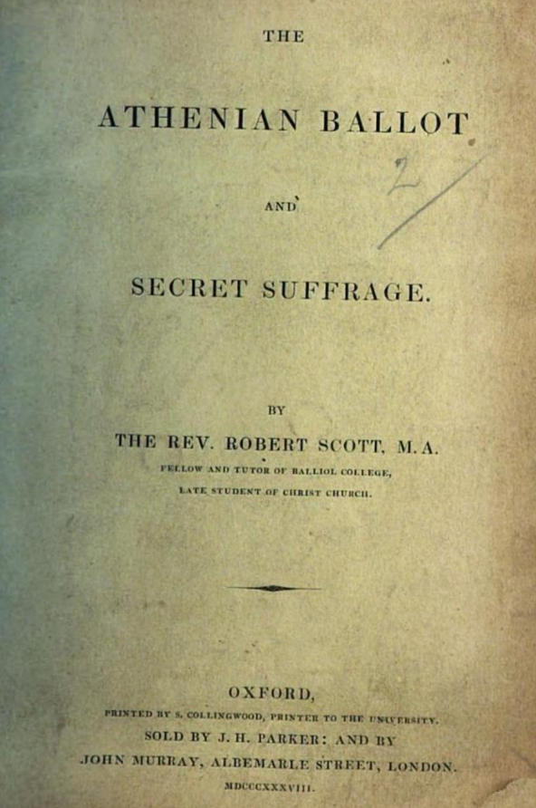
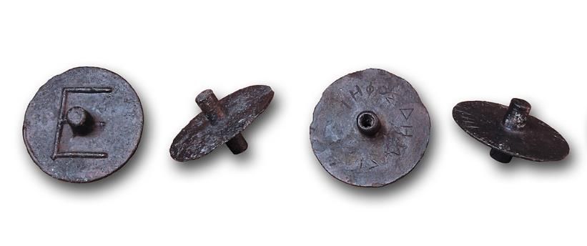
Secrecy is crucial to good democracy
Notes:
Well, it goes back to a principle of democracy that is at least two thousand years old, when Aristotle described the Athenian ballot that was used in ancient Greece, which included tokens for secret voting like these. Now as much as we all love and hail transparency, we also know that too much of any good thing can actually be really, really bad. And what millennia of history has told us is that in some cases,
secrecy is absolutely crucial to good democracy.

Slide 54
Why?
Notes:
Why?

Slide 55
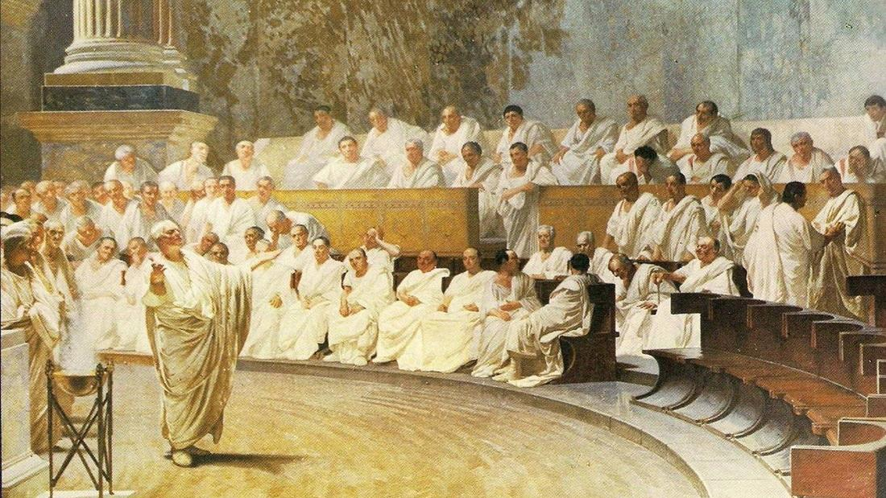
Notes:
Well, back in ancient Greece it was to protect jurors against revenge from the accused.

Slide 56
Notes:
In the early British parliament, secret voting prevented against retaliations from the king

Slide 57
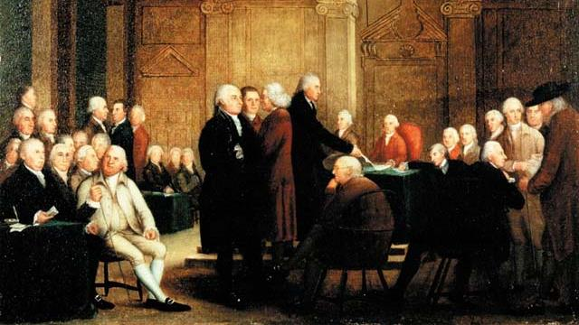
Notes:
Which is why the founders borrowed the practice when they were defining the procedures for the Committee of the Whole in the House of Representatives, which is where all the important tax and spending bills are crafted.

Slide 58
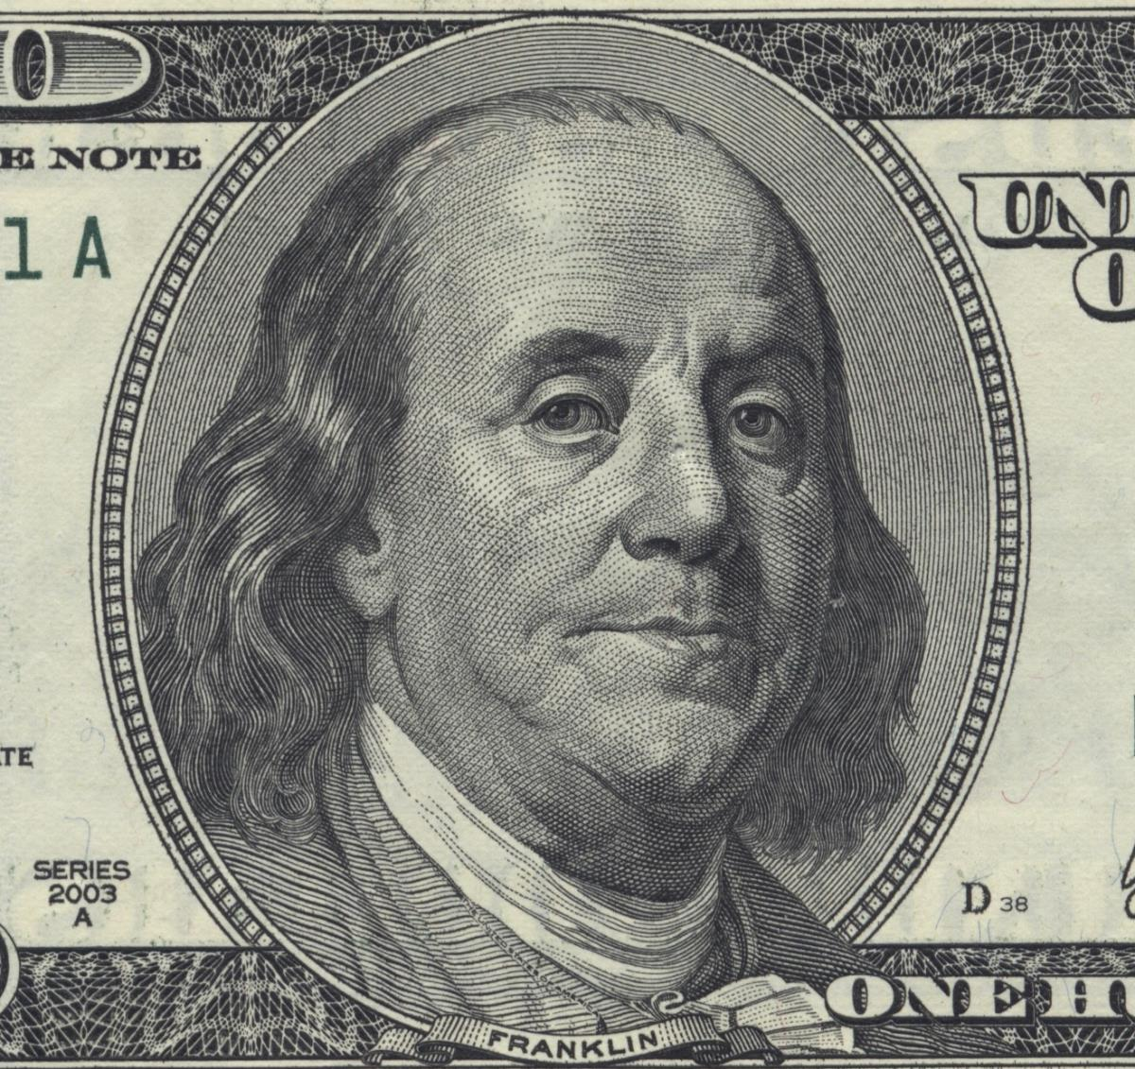
A Republic
If you can
keep it.
Notes:
In fact, even the Constitutional Convention was held in the utmost secrecy in order to prevent subversion, and from which Benjamin Franklin emerged to be angrily asked, Mr. Franklin, what have you wrought? To which, he replied a republic madam, if you can keep it. And ironically, here we are today, having done that very thing.

Slide 59
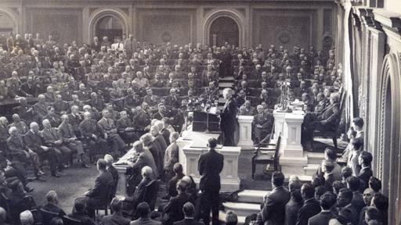
Notes:
Okay, so from the very First Congress through the next 181 years, much of the voting that took place during the process of writing bills actually occurred in secret, which allowed representatives to focus on what best served the people, without fear of any retribution from funders or other established interests.

Slide 60
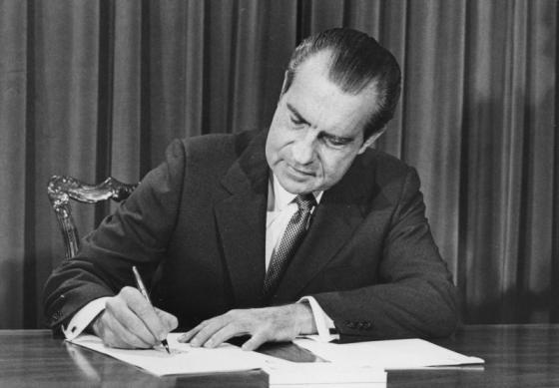
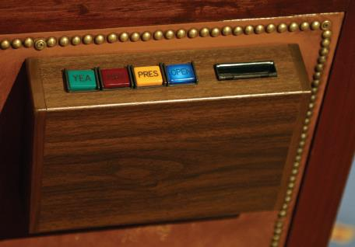
Congressional Reorganization Act of 1970
Notes:
But in 1970, with the stroke of a pen, Nixon set into motion this little regarded “sunshine” reform that discarded this crucial principle of good democracy, and created electronic voting that could now record the identity of every single vote in Congress. Now while back then this was heralded as a victory for transparency and efficiency,

Slide 61
“bills were better when drafted away from lobbyists’ watchful eyes” – CQ Press, 1987
Notes:
After the appeal of ultra-transparency had faded, many former proponents went on to conclude that
bills were actually better when they were drafted away from lobbyists’ watchful eyes

Slide 62
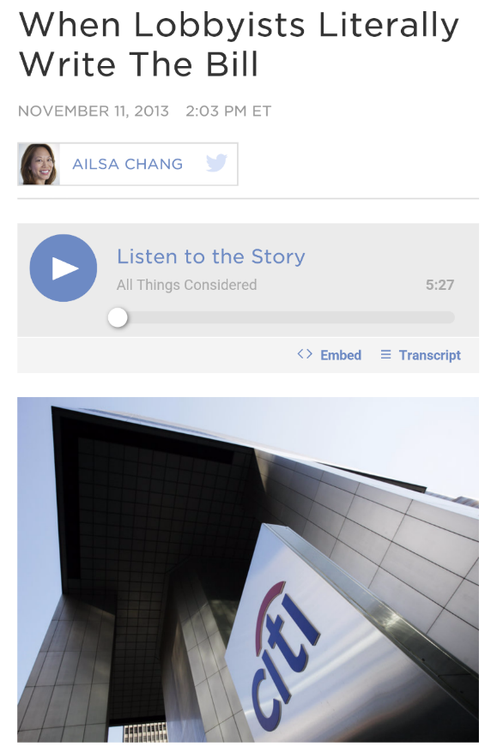
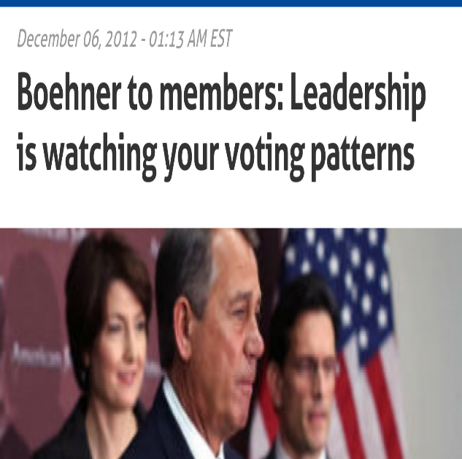
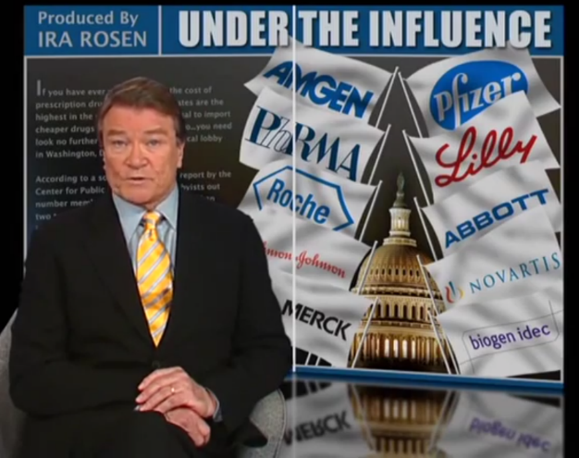
Intimidation and Fraud in Congress?
Notes:
Now some of you might be thinking, intimidation and fraud in Congress? Come on, how bad could it be? Yet when you start looking at it, what you will find is that the problem is actually really quite widespread. Some of the most stark examples include
the unprecedented amount of arm twisting that took place in the passage of Medicare part D
Or that time there was a bill in Congress that had whole paragraphs were copied word-for-word from lobbyists recommendations
And lets not forget when party leadership told its members that they were watching their voting patterns and that if they did not tow the party line, they might not get that committee assignment they really wanted. It is precisely this the kind of leverage that ultimately determines the level of amplification in the cronyism loops,

Slide 63
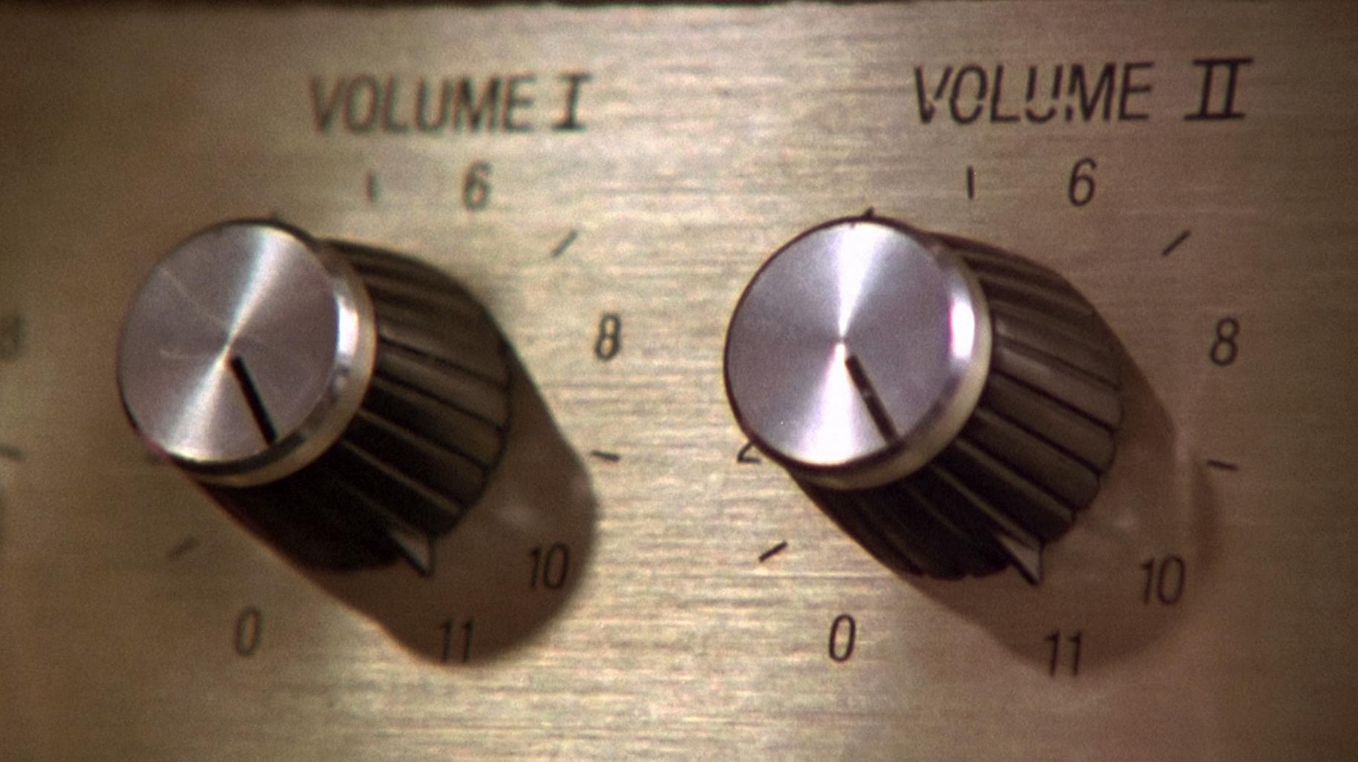
Notes:
and right now the gain is cranked to eleven.

Slide 64
Elitism
Loops
R
+
Elite Favorable
Crony Capitalism
Policy
Congressional Favoritism
Loops
+
Toward Elites
R
+
Lobbyist Policy
+
Transparency
+
Contributions
Leverage Effect
+
+
Elite Income
Indicated Elite
+
Registered
Lobbying
Influence
indicated number
Lobbyists
Gains
of lobbyists
+
+
-
+
+
R
+
Elite
Lobbyist Cost
Total Spending
Influence
Desired
on Lobbyists
Lobbyists
Elite Political
R
+
Investment
B
-
Elite Contributions
+
Over $2700
available funds for
Potential
hiring new lobbyists
Spending on
+
+
Lobbyists
politician effort contacting
+
important donors
Notes:
Okay, so that is crony capitalism, now what about the people? Well they are currently dominated by the elitism loops, which this time are actually reinforcing a decline in many of the important factors related to equality. The first of these begins with the effort that politicians put into contacting wealthy donors, which according to a number of leaked memos can range anywhere from at least thirty to as much as eighty percent of their time. This translates into spending two to six hours every single day, just dialing for dollars. Crazy.

Slide 65
Elitism
Loops
R
+
Elite Favorable
Crony Capitalism
Policy
Congressional Favoritism
Loops
+
Toward Elites
R
+
Lobbyist Policy
+
Transparency
+
Contributions
Total Campaign
Leverage Effect
+
Expenditures
+
Elite Income
Indicated Elite
+
Registered
Lobbying
Influence
indicated number
Lobbyists
Gains
of lobbyists
Total Contributions to
+
-
+
R
Winning Campaigns
+
+
+
+
-
Elite
Lobbyist Cost
Total Spending
Influence
Desired
on Lobbyists
Expected Campaign
Lobbyists
Elite Political
Shortfall
R
+
Investment
B
-
Elite Contributions
+
Over $2700
available funds for
Potential
+
hiring new lobbyists
Spending on
+
+
Lobbyists
politician effort contacting
+
important donors
Notes:
Alright, so now we can figure that the amount of effort they put in is, in part, a function of the total amount that the candidates expect they need to win the election, as compared to what they have already raised.

Slide 66
Trust In
Government
Elitism
-
Loops
Cost per
R
Impression
+
Elite Favorable
Crony Capitalism
Policy
Congressional Favoritism
Loops
+
+
Toward Elites
R
+
Lobbyist Policy
+
Transparency
+
Contributions
Total Campaign
Leverage Effect
+
Expenditures
+
Elite Income
Indicated Elite
+
Registered
Lobbying
Influence
indicated number
Lobbyists
Gains
of lobbyists
Total Contributions to
+
-
+
R
Winning Campaigns
+
+
+
+
-
Elite
Lobbyist Cost
Total Spending
Influence
Desired
on Lobbyists
Expected Campaign
Lobbyists
Elite Political
Shortfall
R
+
Investment
B
-
Elite Contributions
+
Over $2700
available funds for
Potential
+
hiring new lobbyists
Spending on
+
+
Lobbyists
politician effort contacting
+
important donors
Notes:
How much a campaign is expected to cost, is determined by the relative price of advertising, which is in turn affected by voters’ trust in government. That is to say, that as people grow more and more disgusted with politics, the more they try to avoid political messaging

Slide 67


CANDIDATES$
Notes:
which means that candidates then have to spend more and more money on ads convincing this shrinking pool of voters, just to show up at the polls

Slide 68
-
elite favorable
Trust In
Trust In
policy ratio
+
Government
Government
-
Elitism
-
Loops
Cost per
Middle Class
R
Impression
Favorable Policy
-
+
Elite Favorable
Crony Capitalism
Policy
Congressional Favoritism
Loops
+
+
Voter
Toward Elites
R
Engagement
Lobbyist Policy
+
+
Transparency
+
Contributions
Total Campaign
R
Leverage Effect
+
Expenditures
+
Elite Income
Indicated Elite
+
Registered
Lobbying
Influence
indicated number
Lobbyists
Gains
of lobbyists
Total Contributions to
+
-
+
R
Winning Campaigns
+
+
+
+
-
Elite
Lobbyist Cost
Total Spending
Influence
Desired
on Lobbyists
Expected Campaign
Lobbyists
Elite Political
Shortfall
R
+
Investment
B
-
Elite Contributions
+
Over $2700
available funds for
Potential
+
hiring new lobbyists
Spending on
+
+
Lobbyists
politician effort contacting
+
important donors
Notes:
Okay, so trust in government is then related to ratio of policies that favor elites as compared to the policies that favor everyone else, which completes the first of our elitism loops that we call voter engagement.

Slide 69
-
elite favorable
Trust In
policy ratio
+
Government
-
Elitism
-
Loops
Cost per
Middle Class
R
Impression
Favorable Policy
Middle Class
-
+
Political Investment
Elite Favorable
Crony Capitalism
Policy
+
Congressional Favoritism
Loops
+
+
Voter
Toward Elites
R
Engagement
Lobbyist Policy
+
Middle Class
+
Transparency
+
Contributions
Total Campaign
R
Contributions Under $200
Leverage Effect
Expenditures
-
+
Elite Income
+
Indicated Elite
+
Influence
+
Registered
Lobbying
indicated number
Lobbyists
Gains
of lobbyists
Total Contributions to
+
-
+
R
Winning Campaigns
+
+
+
+
-
Elite
Lobbyist Cost
Total Spending
Influence
Desired
on Lobbyists
Expected Campaign
Lobbyists
Elite Political
Shortfall
R
+
Investment
B
-
Elite Contributions
+
Over $2700
available funds for
Potential
+
hiring new lobbyists
Spending on
+
+
Lobbyists
politician effort contacting
+
important donors
Notes:
The next two loops are based on the size of middle-class, small-dollar, contributions

Slide 70
-
elite favorable
Trust In
Voter
policy ratio
+
Government
Participation
-
R
Elitism
-
Loops
+
Middle Class
R
Cost per
Favorable Policy
Impression
+
Middle Class
-
Political Investment
Elite Favorable
Crony Capitalism
Policy
+
Congressional Favoritism
Loops
+
+
Voter
Toward Elites
R
Engagement
Lobbyist Policy
+
Middle Class
+
Transparency
+
Contributions
Total Campaign
R
Contributions Under $200
Leverage Effect
Expenditures
-
+
Elite Income
+
Indicated Elite
+
Influence
+
Registered
Lobbying
indicated number
Lobbyists
Gains
of lobbyists
Total Contributions to
+
-
+
R
Winning Campaigns
+
+
+
+
-
Elite
Lobbyist Cost
Total Spending
Influence
Desired
on Lobbyists
Expected Campaign
Lobbyists
Elite Political
Shortfall
R
+
Investment
B
-
Elite Contributions
+
Over $2700
available funds for
Potential
+
hiring new lobbyists
Spending on
+
+
Lobbyists
politician effort contacting
+
important donors
Notes:
Which rise and fall in relation to voter trust in government to form the reinforcing loops we call voter participation.

Slide 71
-
elite favorable
Trust In
Voter
policy ratio
+
Government
Participation
-
R
Elitism
-
Loops
+
Middle Class
+
Cost per
Income
Middle Class
R
+
Favorable Policy
Impression
+
Middle Class
Voter
-
Political Investment
Elite Favorable
Influence
Crony Capitalism
Policy
+
Congressional Favoritism
Loops
+
+
Voter
R
Toward Elites
R
Engagement
Lobbyist Policy
+
Middle Class
+
Transparency
+
Contributions
Total Campaign
R
Contributions Under $200
Leverage Effect
Expenditures
-
+
Elite Income
+
Indicated Elite
+
Influence
+
Registered
Lobbying
indicated number
Lobbyists
Gains
of lobbyists
Total Contributions to
+
-
+
R
Winning Campaigns
+
+
+
+
-
Elite
Lobbyist Cost
Total Spending
Influence
Desired
on Lobbyists
Expected Campaign
Lobbyists
Elite Political
Shortfall
R
+
Investment
B
-
Elite Contributions
+
Over $2700
available funds for
Potential
+
hiring new lobbyists
Spending on
+
+
Lobbyists
politician effort contacting
+
important donors
Notes:
The next loop adds the relationship to middle class income, which determines how much voter influence there is over policies in Congress.

Slide 72
-
elite favorable
Trust In
Voter
policy ratio
+
Government
Participation
-
R
Elitism
-
Loops
+
Middle Class
+
Cost per
Income
Middle Class
R
+
Favorable Policy
Impression
+
Middle Class
Voter
-
Political Investment
Elite Favorable
Influence
Crony Capitalism
Policy
+
Congressional Favoritism
Loops
+
+
Voter
R
Toward Elites
R
Engagement
Lobbyist Policy
+
Middle Class
+
Transparency
+
Contributions
Total Campaign
R
Contributions Under $200
Leverage Effect
Expenditures
-
+
Elite Income
+
Indicated Elite
+
Influence
+
Registered
Lobbying
indicated number
Lobbyists
Gains
of lobbyists
Total Contributions to
+
-
+
R
Winning Campaigns
+
+
+
+
-
+
Elite
Lobbyist Cost
Total Spending
Desired Campaign
Influence
Desired
on Lobbyists
Expected Campaign
Budget
Lobbyists
Elite Political
Shortfall
R
+
Investment
B
B
-
Elite Contributions
+
Over $2700
available funds for
Potential
+
hiring new lobbyists
Spending on
+
+
Lobbyists
politician effort contacting
+
important donors
Notes:
The final loop, is then another small balancing loop, which ensures that campaigns only raise what they expect they need to win.

Slide 73
-
elite favorable
Trust In
Voter
policy ratio
+
Government
Participation
-
R
Elitism
-
Loops
+
Middle Class
+
Cost per
Income
Middle Class
R
+
Favorable Policy
Impression
+
Middle Class
Voter
-
Political Investment
Elite Favorable
Influence
Crony Capitalism
Policy
+
Congressional Favoritism
Loops
+
+
Voter
R
Toward Elites
R
Engagement
Lobbyist Policy
+
Middle Class
+
Transparency
+
Contributions
Total Campaign
R
Contributions Under $200
Leverage Effect
Expenditures
-
+
Elite Income
+
Indicated Elite
+
Influence
+
Registered
Lobbying
indicated number
Lobbyists
Gains
of lobbyists
Total Contributions to
+
-
+
R
Winning Campaigns
+
+
+
+
-
+
Elite
Lobbyist Cost
Total Spending
Desired Campaign
Influence
Desired
on Lobbyists
Expected Campaign
Budget
Lobbyists
Elite Political
Shortfall
R
+
Investment
B
B
-
Elite Contributions
+
Over $2700
available funds for
Potential
+
hiring new lobbyists
Spending on
+
+
Lobbyists
politician effort contacting
+
important donors
Notes:
Alight, so when we put this all back together what we see is that with all the elitism loops pushing voters down and all the crony capitalism pushing elites up we now have a way to precisely measure the overall direction that our country is headed, so that when we ask the question

Slide 74
How did we get here?
Notes:
How did we get here? We now have a definitive answer. Alright, so let’s go look at the actual model.

Slide 75
Notes:
Okay, so now that we have a model that is properly calibrated to how we got here, we can now finally ask

Slide 76
How do we fix it?
Notes:
How do we fix it?

Slide 77

Vouchers: $50 tax rebate per election ($25 per year) for each voter
Small Dollar Match: 6 to 1 or 9 to 1 match of contributions under $150
Media Cost Controls: Sets lowest unit cost for campaign ads
Notes:
Well fortunately there is already legislation that has been proposed in Congress that includes three different policies that we can now try out. The first is a voucher system that provides a fifty dollar tax rebate per election, so twenty-five dollars per year, for each voter
The second is a small dollar match of either six to one or nine to one for amounts under $150
And the third, are media cost controls that set the lowest unit cost for campaign ads

Slide 78
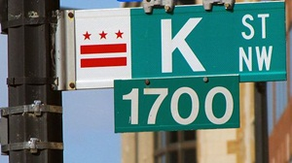
Reduce Leverage: Secret process, transparent final bill
Notes:
Yet this bill is still missing a very crucial part, and that is the leverage that elites and lobbyists enjoy from being able to see precisely who is delivering on investments to stuff favorable policies into bills in Congress.
To counter this we propose a fourth policy, which makes the process of crafting bills secret, and shifts the focus of transparency onto the final bill. Because lets face it, average citizens are not ever going to watch every move in Congress and even if they did, what leverage would they have on a daily basis? It is only the quality of the final bills that actually matters, and that is what we should be holding members accountable for come election day. If representatives could craft bills away from the microscope of invested interests, history has told us time and again that they will deliver a much better product. Okay, so now lets go back to the model and start looking into the future.

Slide 79
Notes:
Okay, so now we know in more precise terms than ever before, how we got here and what each policy can do to restore citizen equality.

Slide 80

Notes:
All we need to know now is, what is the master combination?

Slide 81
As citizens, can we be equal again?
Notes:
Alright, so if you made it this far, congratulations, you now know without any doubt that right now, we have lost citizen equality in a big way, and that is hurting each and every one of us outside that tiny group of elites. Yet this is not a problem without a solution. In fact the solutions are really quite simple, because they do not infringe upon the freedom of speech and expression, which means they can be passed right now in Congress. This means that when someone asks you the question:
As citizens, can we really be equal again, you can now answer

Slide 82
YES
Notes:
YES, yes we can have equal representation in Congress once again.

Slide 83
Notes:
Alright, well thanks everyone for watching. Please feel free to visit Bruce Skarin dot com to download the full paper, data, and models that were used in this presentation. Along with this presentation itself, then share, remix, and do whatever you can to help bring our nation back to the people. Because after decades of corruption we still have a ton of work to do in fixing this mess, but once we take care of this first problem, then as Lessig promises, great things, American things, will be possible once again.

Slide 85
Alternate Slides
For presentations without the actual simulation model

Slide 86
How did we get here?

Slide 93
So how do we fix it?

Slide 97

Voucher and Media Cost Control Combination
Voucher, Media Cost Control, and Reduce Leverage Combination

